Slide 1
GovState
graduate
EXPERIENCE

Slide 2
“To Grad School or Not to Grad School”
…Is It A Question?
Notes:
Intro – Overview of presentation. Why you should go to grad school, choosing the right program, why GSU. Funding at the end as well

Slide 3
Opens Doors to a New Career
Careers require/prefer a Master’s Degree
- Psychologist
- Education Administrator
- Mental Health Counselor
- Political Scientist
- Occupational Therapist
Careers that require/prefer a Doctoral Degree
- Physical Therapist
- School Superintendent
- College Professor
Notes:
Some reasons why people decide to attend grad school. Career advancement/change. Career goal requires an advanced degree

Slide 4
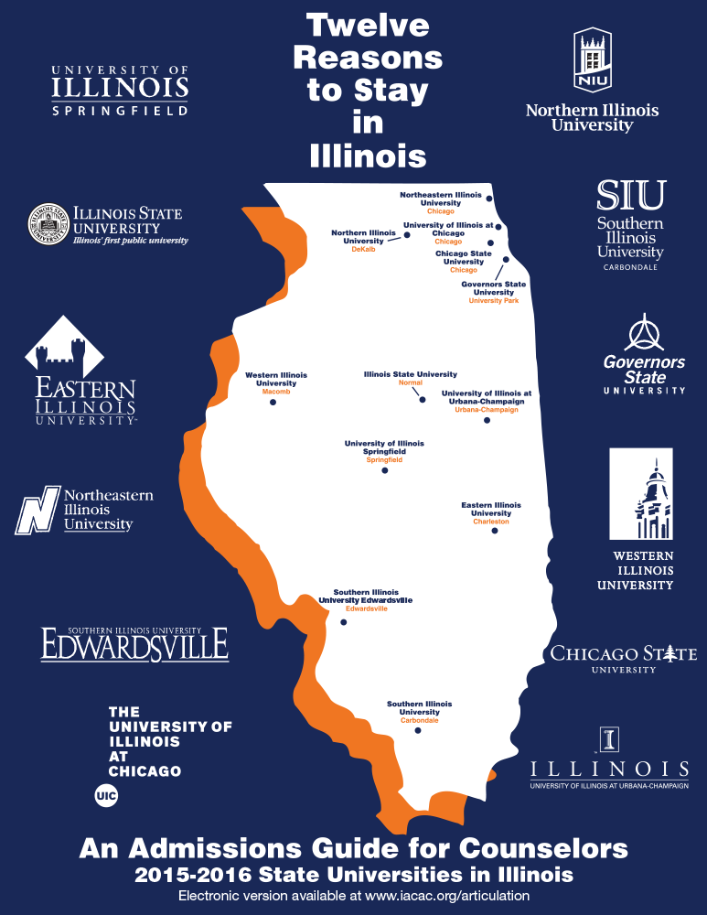
GovState Quick Facts
- Founded in 1969
- 1818 Graduate Students Enrolled
- 17-1 Student-Faculty Ratio
- 49,000 alumni
- 52 Graduate programs

Slide 5
Increase Earning Potential
-Individuals with a Master’s Degree have an average starting salary of $81,848.
-Individuals with a Doctoral Degree have an average starting salary of $99,268.
*Bureau of Labor Statistics, 2021
Notes:
Shows the financial advantage of getting a graduate degree

Slide 6
Why GovState?
Affordable Tuition
The average cost of tuition for a public university in Illinois is $10,177.00 compared to $8244.00 at GSU – saving you 18.9%*
Award Winning Faculty
Our faculty come from some of the world’s leading universities including Northwestern University, NYU, McGill, and the University of Chicago.
From Professor Fraud to Emmy-Award winners the GSU faculty are leaders in their fields.
Flexible Delivery Formats
Find classes that fit around your busy schedule.
Notes:
GSU is one of the most affordable universities in the state. Great faculty and staff. Bill Kressie (Professor Fraud) multiple Emmy winners (Yvette Brown and Tony Labriola)

Slide 7
College and Programs – (Masters)
College of Arts and Sciences
- Master of Arts English
- Master of Art in Communication, Media, and Performance
- Master of Art in Public Administration
- Master of Art in Political and Justice Studies
- Master of Art in Criminal Justice
- Master of Fine Art in Independent Film
- Master of Fine Art
- Master of Science in Information Technology
- Master of Science in Computer Science
- Master of Science in Analytical Chemistry
- Master of Science in Environmental Biology
- Master of Science in Mathematics
- Master of Science in Mathematics – Teacher Education
Notes:
Don’t name them all, just let them be wowed by the comprehensive list maybe highlight one or two on each slide.

Slide 8
College and Programs – (Masters)
College of Business
- Master of Business Administration (In-Person and Online)
- Master of Science in Accounting
- MBA in Supply Chain Management
- Master of Science in Business Analytics
- Master of Science in Human Resource Management
College of Education
- Master of Arts in Education Administration
- Master of Arts in Special Education
- Master of Arts in Early Childhood Education
- Master of Arts In Counseling
- Master of Arts in Psychology
- Education Specialist
Notes:
Wow!

Slide 9
College and Programs – (Masters)
College of Health and Human Services
- Master of Health Science in Communication Disorders
- Master of Health Science in Addictions Studies
- Master of Health Administration
- Master of Science in Health Informatics
- Master of Science in Nursing
- Master of Occupational Therapy
- Master of Social Work
Notes:
Wow

Slide 10
College and Programs – (Doctoral/Certificates)
Doctoral Programs
- Doctor of Education (EdD) in Interdisciplinary Leadership
- Doctor of Philosophy (PhD) in Counseling and Supervision
- Doctor of Physical Therapy (DPT)
Certificates
- Bilingual/Bicultural Education
- Online Teaching
- Biology/Chemistry/English/Math Social Studies Education
- Early Childhood Education
- Data Analytics
- Digital Forensics
- Family Nurse Practitioner
Notes:
Wow

Slide 11
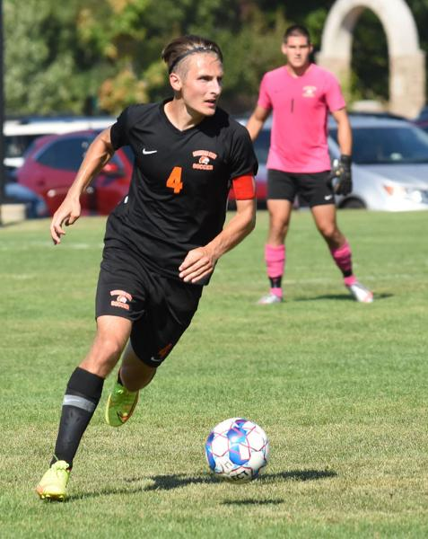
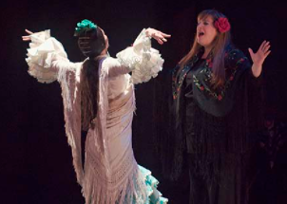
Campus Life for Grad Students
Take in a game.
See a show.
Take a walk through nationally recognized sculpture park.
From sporting events to a theater production there is something for everyone at GSU.
Notes:
Talk about athletics, the CPA, the Nate

Slide 12
Clubs and Student Organizations
Social Organizations
ArtForum – A Student community sharing an appreciation for contemporary art
ALAS – Association of Latin American Students
BSU – Black Student Union
ICO – International Culture Organization
Jaguars Gaming Club – Social and competitive gaming opportunities
Pheonix Newspaper – Student run newspaper
Reconstructed – A creative outlet for student to publish works.
Academic/Programatic Organizations
Accounting, Finance and Economics Club
American Advertising Federation
GSU Psychology Club
International Business Club
Social Work Student Club
Notes:
Something for everyone from programmatic clubs and orgs to profession based, to social, there is an org for everyone.

Slide 13
Mission:
The GSU-GPN represents and supports the interests of the University’s graduate student community by supporting scholarly activities and providing opportunities for professional development. The GPN serves as a liaison between the graduate student body and the administration to encourage communication and cooperation.
Activities:
Monthly Networking Events
Professional Development Workshops
Recreational Athletics
Notes:
Every grad student is a mentor. We work with departments to host a variety of events and to build a community among the graduate student population.

Slide 14
Ways to Connect
Direct Link: www.govst.edu/admissions/
Spanish Language Virtual Appointments Available
Notes:
In person Tours are also available

Slide 15
Financing Your Graduate Studies at GovState

Slide 16
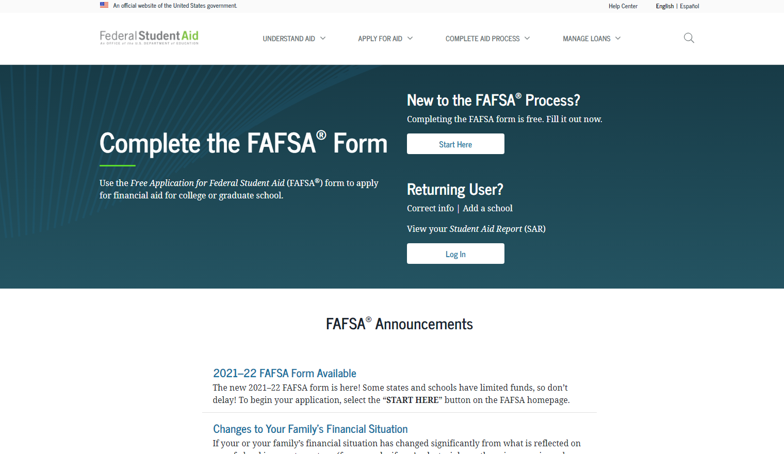
How Do I Apply for Financial Aid?
Have you done the #FAFSA?
Free Application for Federal Student Aid
Found online at studentaid.gov
Direct Link: (https://studentaid.gov/h/apply-for-aid/fafsa)
Update for 24/25 FAFSA

Slide 17
Types of Financial Aid for Graduate Students
Loans
Graduate students are eligible to borrow up to $20,500 annually. Traditionally split over Fall and Spring.
Direct Plus Loans
Scholarships
Student Employment Opportunities
FWS
Graduate Assistantships

Slide 18
Graduate Student Loans
1. Federal Direct Loans*
-Unsubsidized
-Graduate PLUS
2. Private Student Loans
*Students must be enrolled in at least half-time status with Financial Aid eligible coursework to qualify for Federal loans. Masters is 6 credit hours, Doctoral is 3 credit hours.

Slide 19
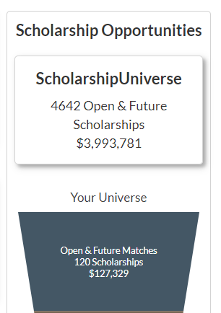
Scholarships
GSU Scholarship homepage: www.govst.edu/Scholarships/
Scholarship Universe: www.govst.scholarshipuniverse.com/public
With Scholarship Universe, Students will be able to:
Answer questions and match to scholarship opportunities they are eligible for
The more you answer, the more scholarships you match to
Easily apply online to multiple scholarship opportunities through a personalized portal
See scholarship metrics to determine their chances and effort required to apply
Be alerted whenever they are matched to new scholarship opportunities
GSU and external scholarships
All vetted = no questioning if the scholarship is legit

Slide 20
Federal Work Study
Allows students to earn money to help pay for educational expenses
Employment on or off-campus
Minimum wage or higher
Gain valuable work experience
Great networking experience
FAFSA is required
https://www.govst.edu/work-study/ https://www.govst.edu/employment-resources
Notes:
FWS is a government allotment to work on campus up to the amount on their award letter
All jobs pay $15 an hour or more
These are typically assistant-type roles (answering phones, emails, etc)
I always mention during down-time they can typically get their HW done
Gain work experience and get to explore different areas within the university
Talk about that’s how you got your job here ☺

Slide 21
Graduate Assistantships
https://www.govst.edu/employment-resources/
-Gain valuable work experience
-Work up to 30-40 hours per pay period in exchange for a stipend and tuition waiver
-Search for available jobs on Jobs For Jaguars

Slide 22
Financial Aid Link “F.A. Link”
Students can use the funds left over after their tuition/fees are covered in the bookstore- online and in-person
You must remain F.A. eligible to use the funds in the bookstore-
If you make any purchases at the bookstore with your F.A. Link and then adjust
your schedule, you may end up owing money
Using FA Link is a voluntary service that is not required
Term | FA Link Opens and Closes
SPRING 2024 | 11/20/2023 – 2/2/2024
SUMMER 2024 | 4/16/2024 – 5/31/2024

Slide 23
Office of Financial Aid
Phone: (708) 534-4480
Email: faid@govst.edu
Website: www.govst.edu/financialaid

Slide 24
Admission Requirements
Master’s Admission Requirements
All applicants must:
-Have earned (or will have earned by the term they wish to enroll) a bachelor’s degree from a regionally accredited college or university.
-Have been in good standing at the last institution attended.
-Have satisfied collegial and/or major criteria, if applicable, for graduate study in a specific major.
-Submit official transcripts from all previously attended institutions demonstrating a fulfillment of the above three items) to the office of admissions.
Doctoral Admission Requirements:
Governors State University’s doctoral programs have varied requirements for admission: check the GSU Catalog for specific admission requirements, application forms, deadlines, and required materials.
Notes:
These are the GSU minimum requirements, many graduate programs have additional requirements and higher grade point average thresholds.

Slide 25
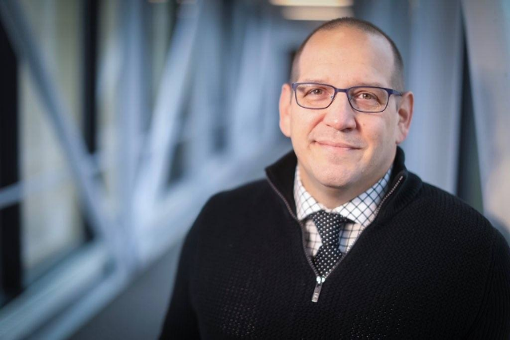
apply.govst.edu/apply
Jason Vignone
Director of Graduate Admissions and Retention
jvignone@govst.edu

Slide 26
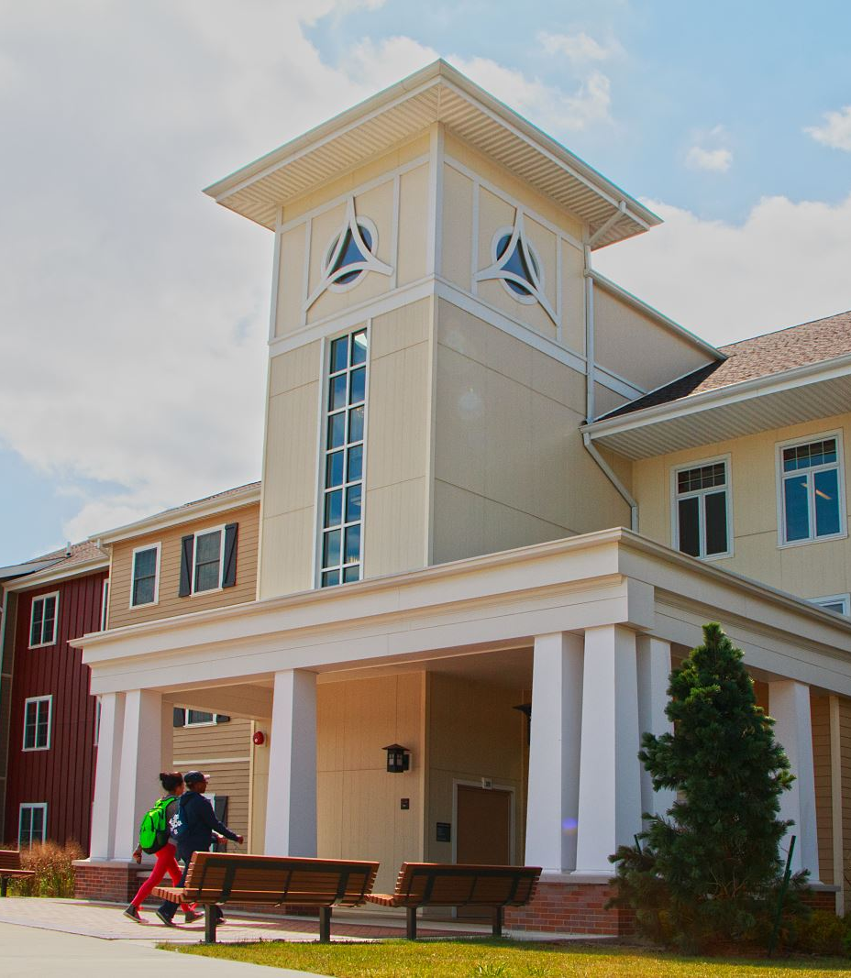
BREAKOUT SESSIONS GovState Student Panel
Engbretson
Campus Resources
Hall of Honors
Housing & Student Engagement
Lakeside Lounge

